Slide 1
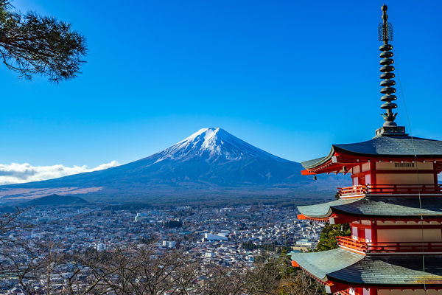
Mt. Fuji Safety Briefing
Yokota Outdoor Recreation
Bldg.564 225-4552

Slide 2
① Fuji Facts
It’s the 2nd largest single mountain in the world and it’s as high as 8.5 Empire State Buildings.
This hike will require little expertise and the proper equipment, not doing so may result in serious injury or even death.

Slide 3
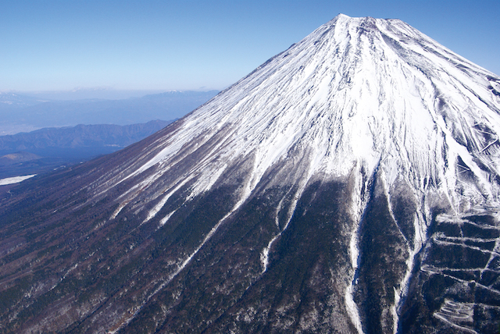
Highest mountain in Japan
12,388 ft (3,776 m)
Anyone in good physical condition can climb Mt. Fuji, although it is not easy and should be approached as a physical and mental challenge.

Slide 4
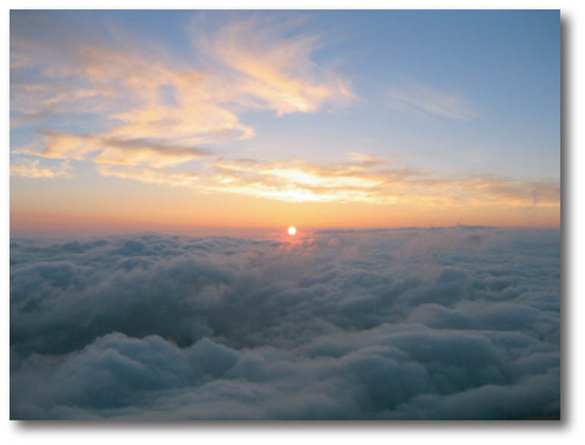
40℉ (4 ℃) !
This is the average temp. in mid-summer on the summit. It can even get colder depending on the weather.
It is usually very cold in the morning and during the night, even in summer.

Slide 5
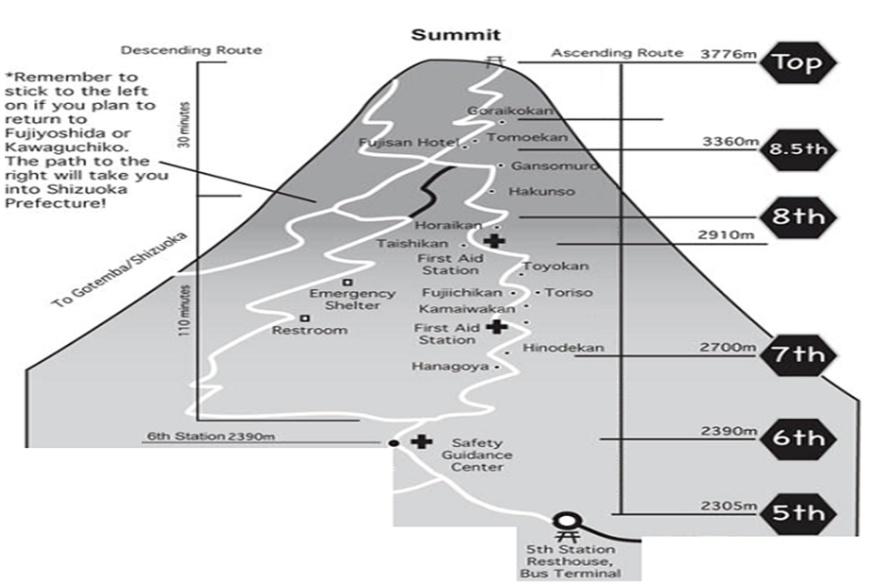
Descent Route
Ascent Route
Main split, go left !
The path to the right will take you into Shizuoka Prefecture.
Ascent: 5-8 hours
Descent: 3-5 hours
( average time )
5th Station Bus Terminal
Fuji-Yoshida Route : The most popular route to climb to the summit.

Slide 6
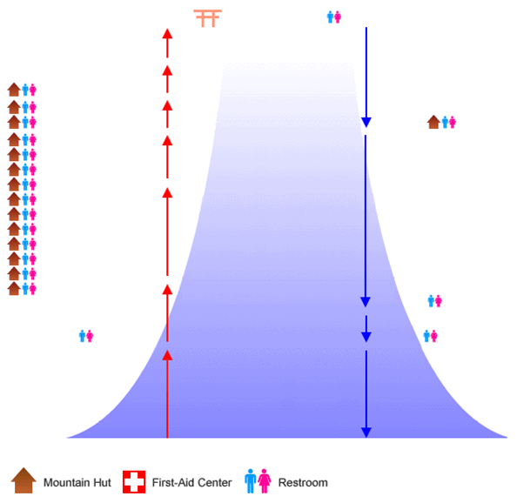
PM 1:00
Summit 3,776m
PM 1:00
PM 12:20
30-50 min
9th Station 3,576m
30-45 min
25-45 min
AM 11:40
Goraikokan
8th Sta. Tomoekan
Fujisan Hotel
Gansomuro
Hakuunso
Horaikan
Taishikan
Toyokan
Toriiso
Fujiichikan
Kamaiwakan
7th Sta. Tomoekan
Hinodekan
Hanagoya
8.5th Station 3,454m
AM 11:00
30-50 min
PM 1:45
Main 8th St.3,374m
50-80 min
AM 09:40
8th Station 3,040m
115-190 min
60-95 min
AM 08:10
7th Station 2,700m
Descent Route
7th Station
PM 4:55
60-95 min
AM 06:35
PM 5:35
25-40 min
6th Sta. Safety Guidance Center
☎ 0555-24-6223
15-25 min
40-65 min
AM 05:30
PM 6:00
5th Station 2,305m
Time limit at each station to
ensure not missing the bus !!

Slide 7
Don’t get lost !
Trail signs are color coded to match specific routes.
Be careful not to take a wrong descending trail.
Be sure to follow correct signs colored in yellow.
Key words !
Yoshida Trail
Kawaguchiko-town
Subaru-line
Yamanashi prefecture

Slide 8
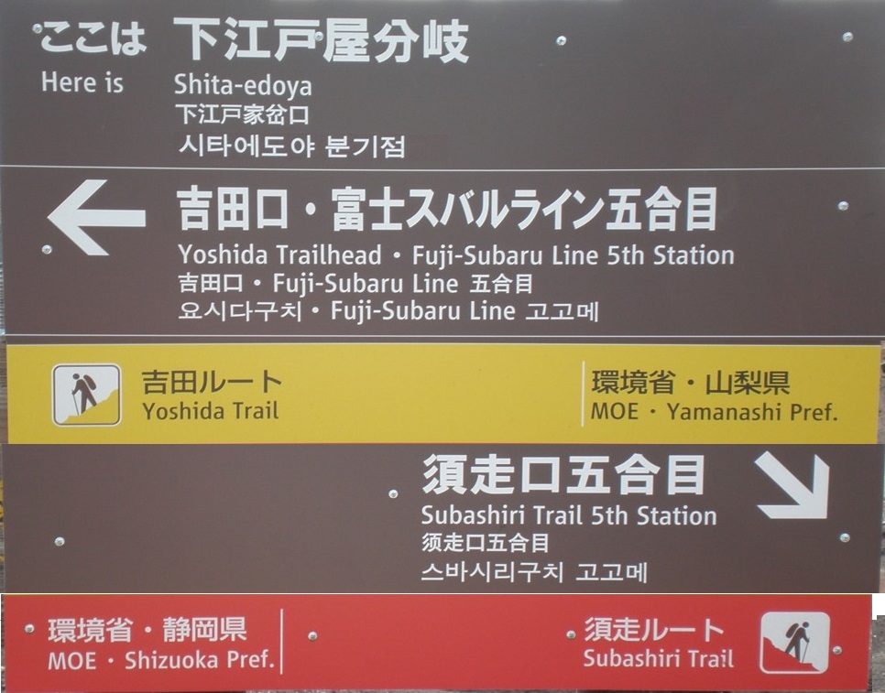
Color coded sign

Slide 9
② Preparation
Limit caffeine & alcohol 24 hours prior
Get lots of sleep (at least 8 hours of sleep)
Attain proper equipment

Slide 10
Packing
Go through the supply checklist in the Mt. Fuji pamphlet.
Remember to pack necessities only and avoid “nice to have” supplies.
Less weight also means better balance.

Slide 11
③ Equipment & Supplies
An absolute minimum set of clothing for climbing Fuji would be:

Slide 12
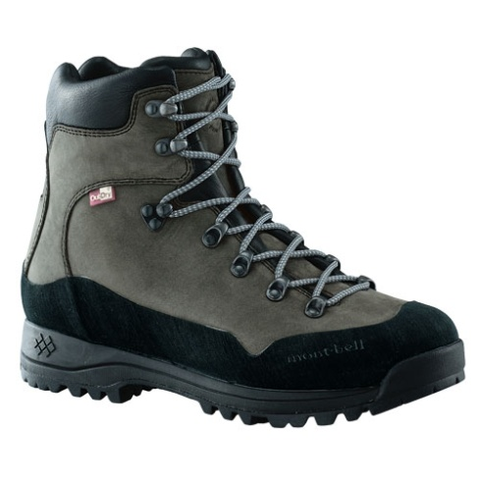
Hiking boots (No Sneakers)
The rocky, steep terrain in some sections are reasons to bring proper hiking shoes which protect and support your ankles.
Available for rent.

Slide 13
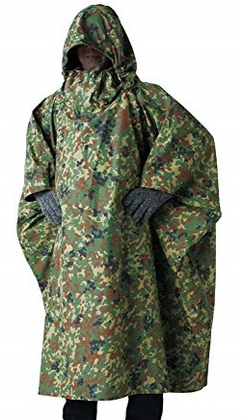
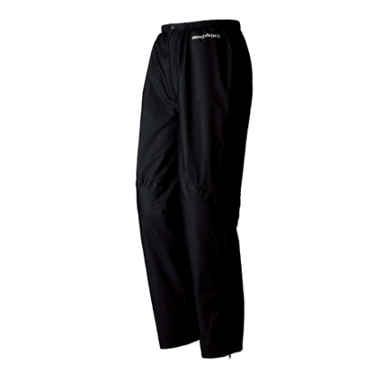
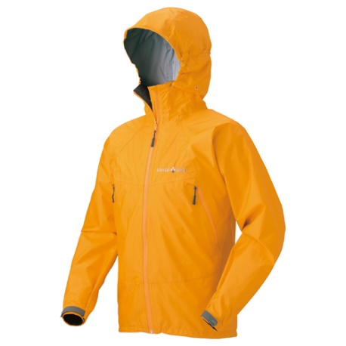
Rain gear (No Poncho)
×
Bring rain gear, as weather conditions can change very quickly
on the mountains.
Available for rent.
Rain or shine we will climb Mt. Fuji

Slide 14
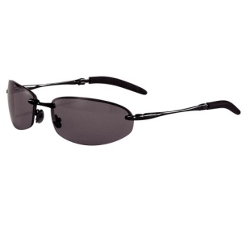
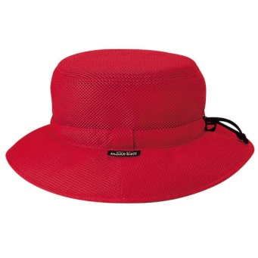
Prevent sunburn
Head cover, sunglasses, long-sleeve shirt and sunscreen are items to protect yourself from sunburn.
You will be subjected to direct sunlight all day.

Slide 15
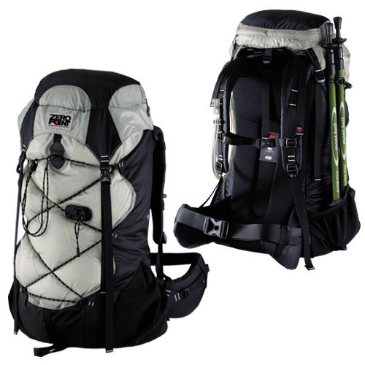
Backpack
Bring along 25-40 liter backpack with a shoulder and hip belt.
Available for rent.

Slide 16

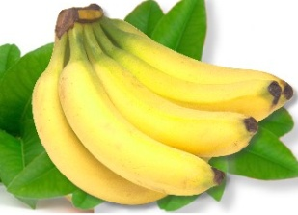
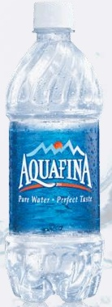
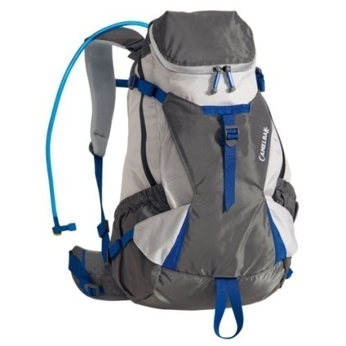
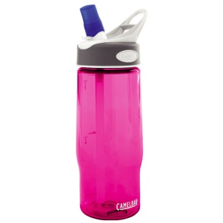


High calorie food, snacks & drinks
It is important to bring enough water and food.
Bring along at least 1.0 liter of water per person.
Mountain huts offer various meals and drinks.
However, the prices increase with the altitude.

Slide 17
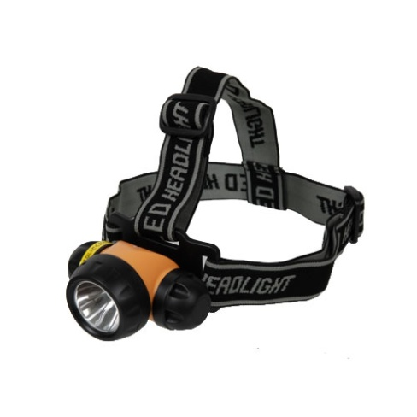
Headlamp or flashlight
& extra batteries
Most people choose head lamps, as they leave both of your hands free.
Available for rent.

Slide 18
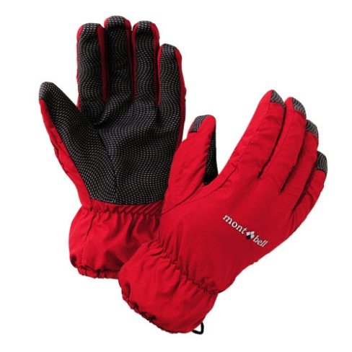
Gloves
Gloves are also strongly recommended to protect against the coldness and for hiking the steep and rocky passages.
Available for purchase.

Slide 19
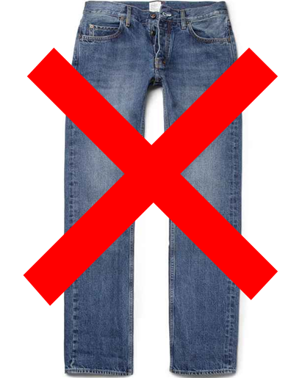
Clothing (No Jeans)
No cotton or jeans because once wet, your body core temp. will drop quickly and it will not dry so quick.

Slide 20
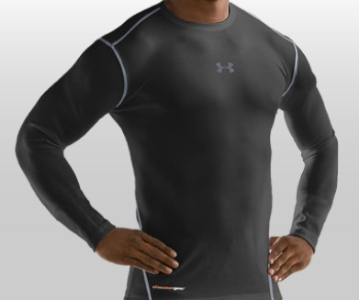
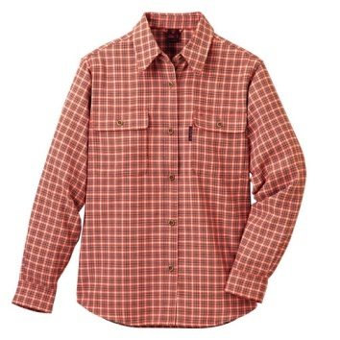
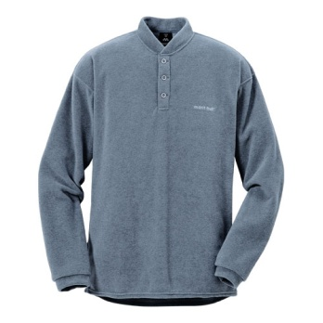
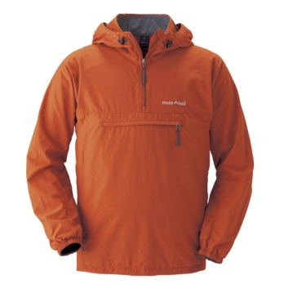
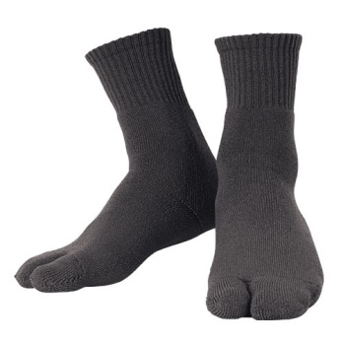
Clothing (Layers)
It is advisable to dress in removable layers such as a base layer, T-shirt, sweater and light jacket so that you will not be too hot while hiking and not too cold at the summit.
Long-sleeve shirt is strongly recommended to protect yourself from sunburn.

Slide 21
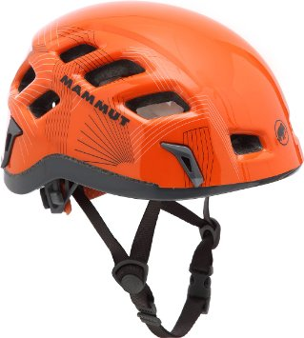
Helmet
After more than 60 people died when a nearby volcano, Mt. Ontake erupted without warning in 2014, we will strongly urge climbers to be equipped with a helmet, dust mask and goggles.
Even bike helmet is better than nothing.

Slide 22
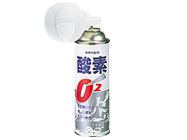
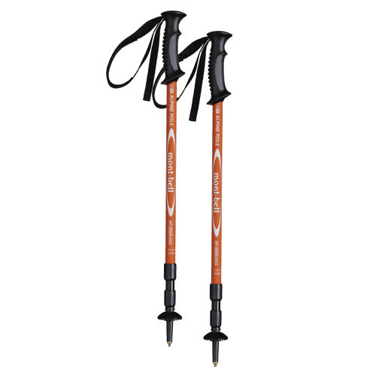
Helpful Items
Oxygen is an effective tool in preventing and fighting altitude sickness (available for purchase)
Trekking poles for better balance and support (available for rent)
Camera for the spectacular views!

Slide 23
Other supplies
Plastic bags for garbage or to keep items in your backpack dry
Small towel (for sweat or dust)
Extra Japanese-yen
Bandages, aspirin or other pain reliever
Change of clothes (you can leave it on the bus)

Slide 24
④ Expenses
Trail admission fee ¥2,000, Mt. Fuji conservation cooperation fund 1,000 yen (voluntary donation)
Climbing stick & stamps
Toilet fees (toilets are pay-per-use and cost 200-300 yen)
Emergency water, food or oxygen
Train or taxi fare (in case you get lost)
Total suggested ￥20,000 & ￥100 coins

Slide 25
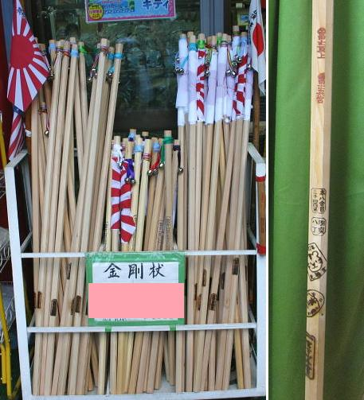
Souvenir climbing sticks
Can purchase at Mt. Fuji.

Slide 26
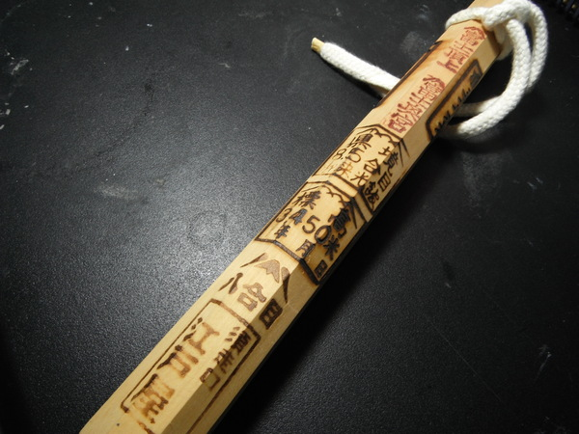
Souvenir stamps (200-500yen)
You can have your hiking stick stamped at the huts.

Slide 27
⑤ Climbing Precaution
Set a slow and steady pace from the beginning and avoid overexertion.
It is better to take frequent short breaks rather than to stop only a few times for long periods of rest.
Prevent dehydration.

Slide 28
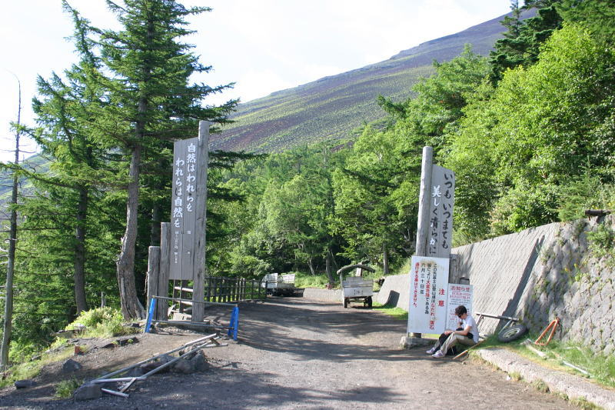
The beginning at the 5th station

Slide 29
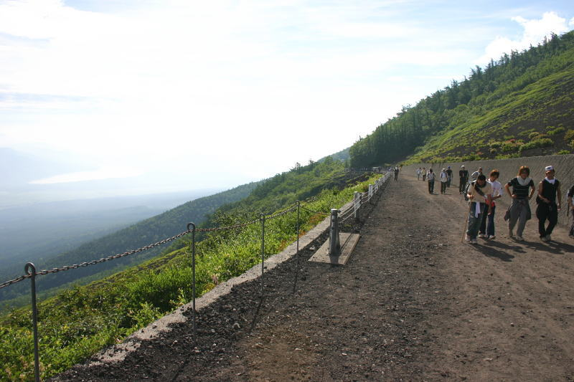
Starts off with a little downhill

Slide 30
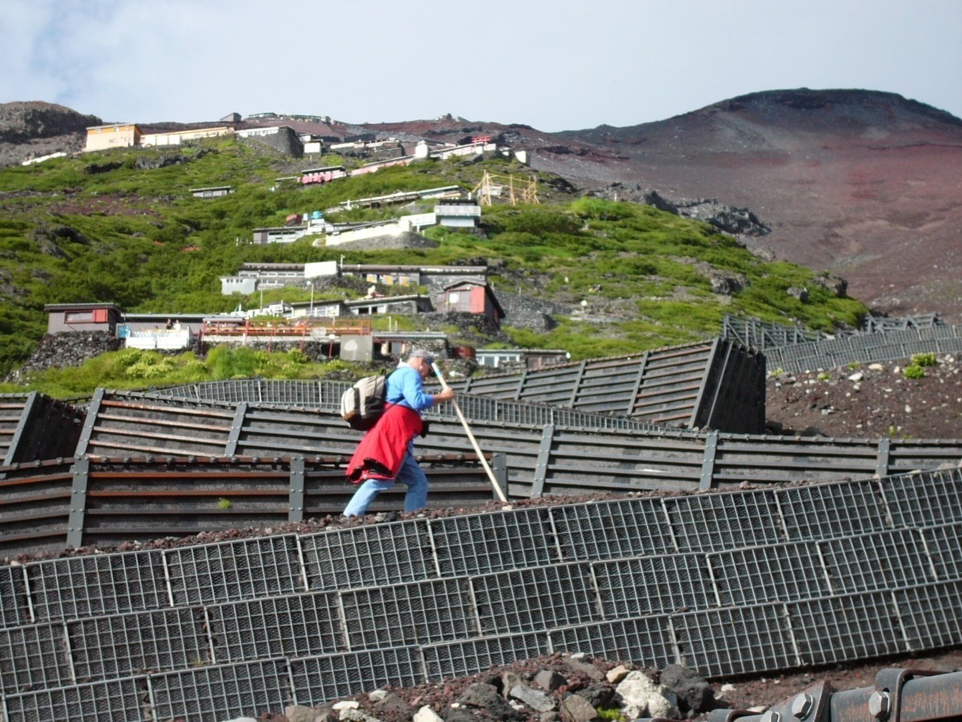
Slow and steady pace is the key!

Slide 31
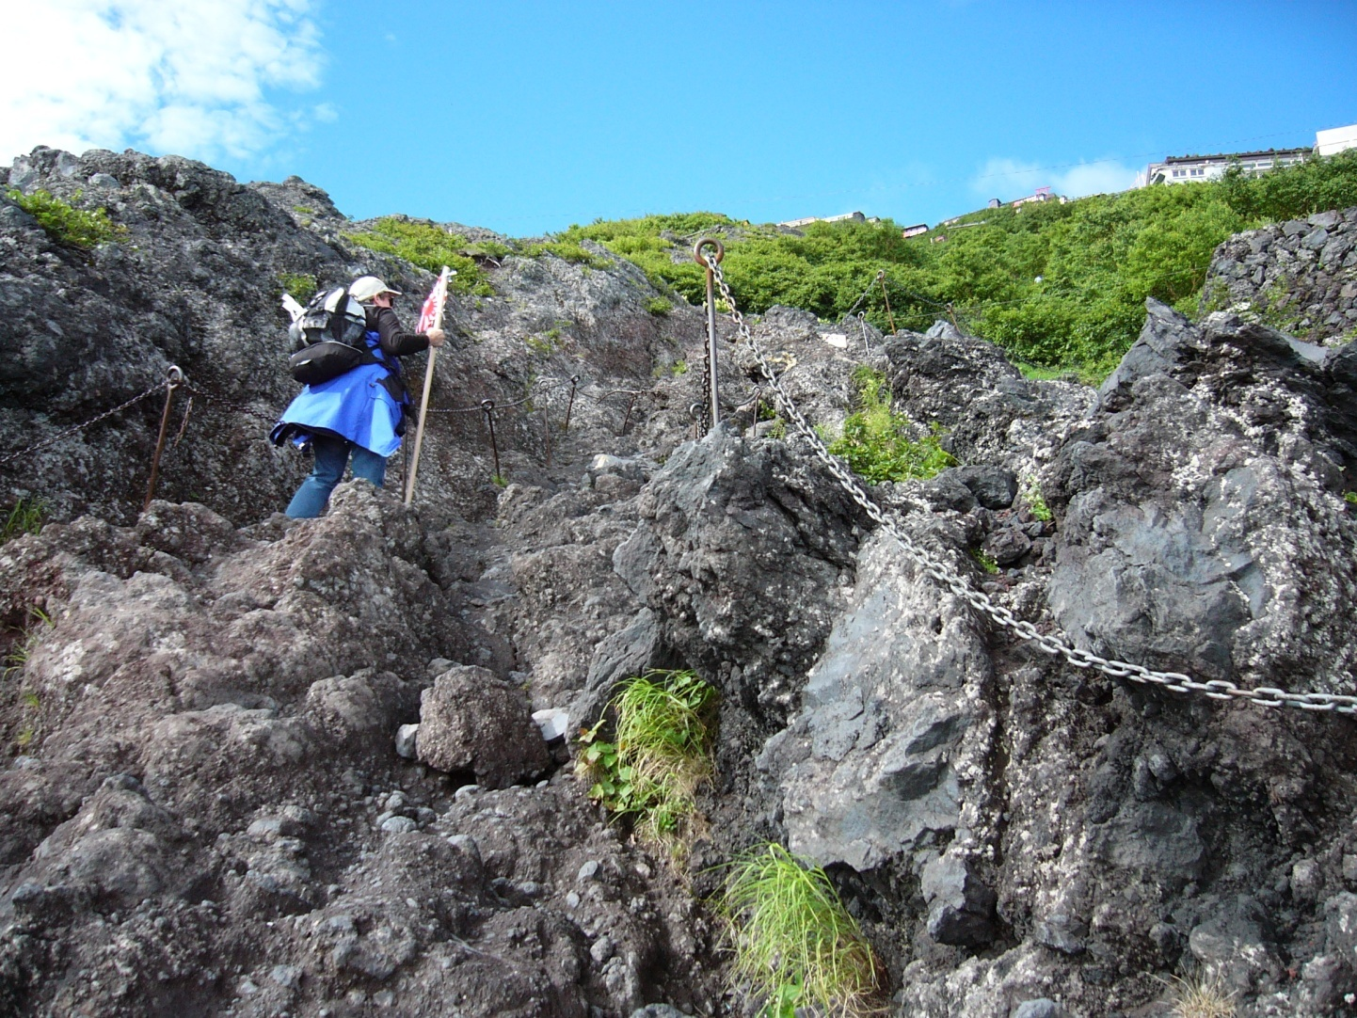
The rough terrain

Slide 32
Safety
Refrain hiking away from marked trails and watch your step.
Rock slides are frequent.
If you see or hear a rock slide, shout to alert other climbers and take cover.

Slide 33
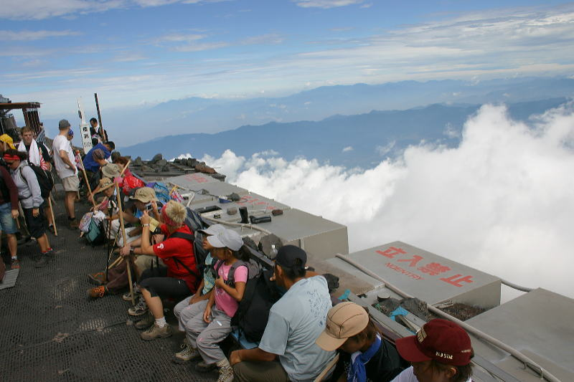
8th station

Slide 34
Warning ①
Near the top the air is noticeably thinner (70%), which may cause altitude sickness and breathing difficulties.

Slide 35
Altitude Sickness
Altitude sickness is caused by decrease of oxygen.
Symptoms include headache, decreased appetite, fatigue, shortness of breath, dizziness and nausea.
To avoid altitude sickness, hike at a slow and steady pace, make frequent short breaks, drink plenty of fluids, eat food high in calories, and avoid alcohol and tobacco.
Small bottles of oxygen can be an effective tool in preventing and fighting altitude sickness.

Slide 36
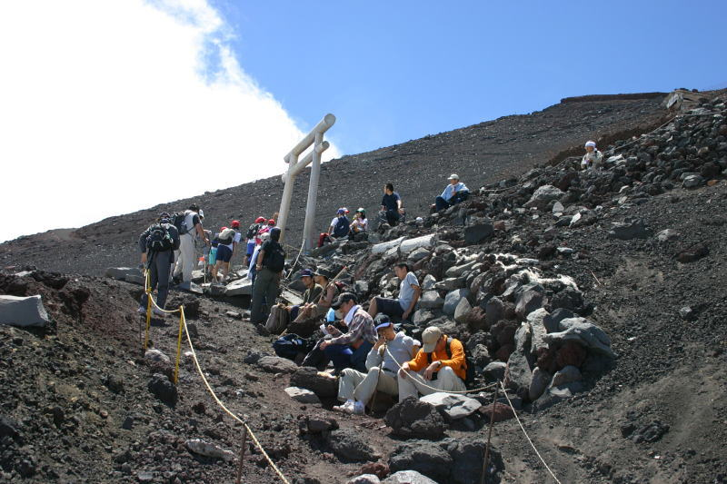
Little above the original 8th station

Slide 37
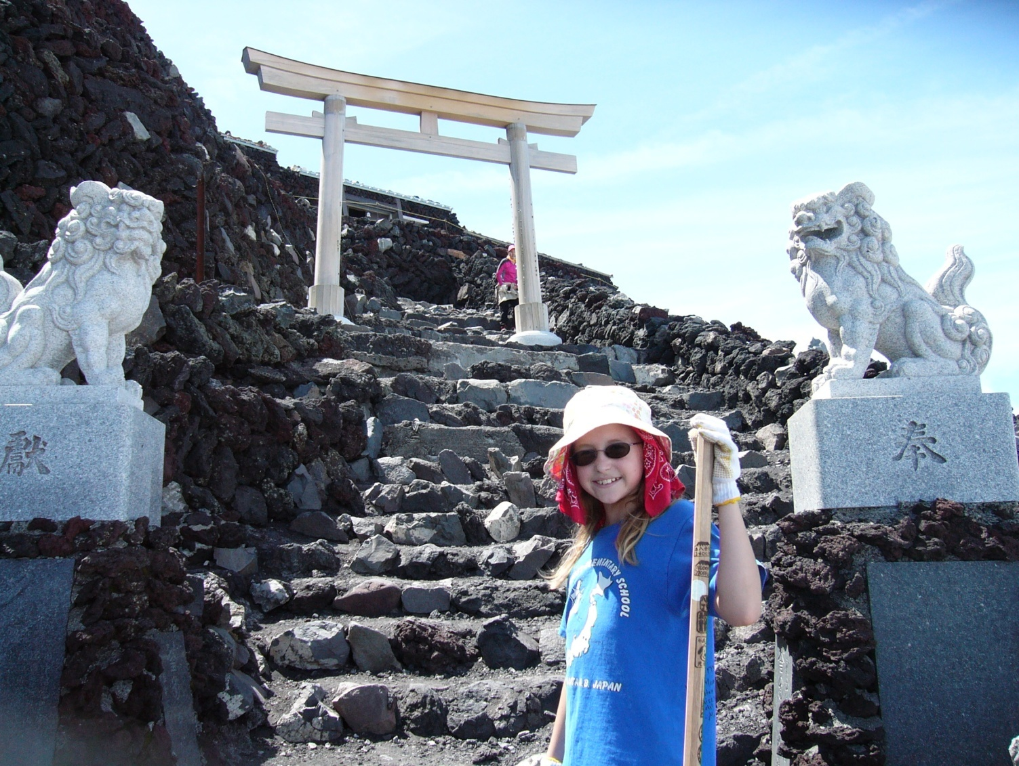
Almost there!

Slide 38
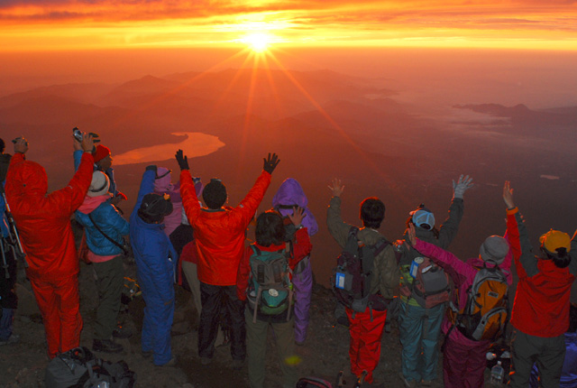
View of the Sunrise

Slide 39
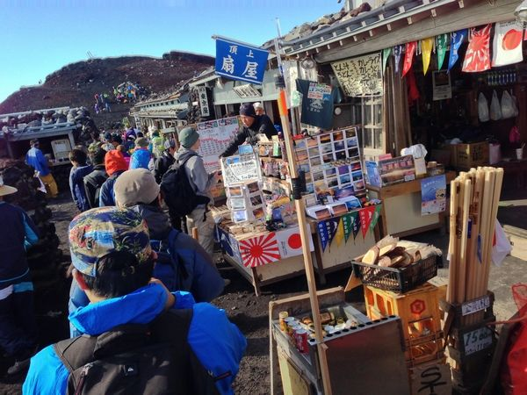
Summit vendors

Slide 40
When you reach the top
There are vendors lined up for about 75 meters and at the end there is a restroom.
Behind this restroom is the entrance to the descent trail.
Just remember to head down the correct descent trail before the turn around time because there are other descent trails along the crater.

Slide 41
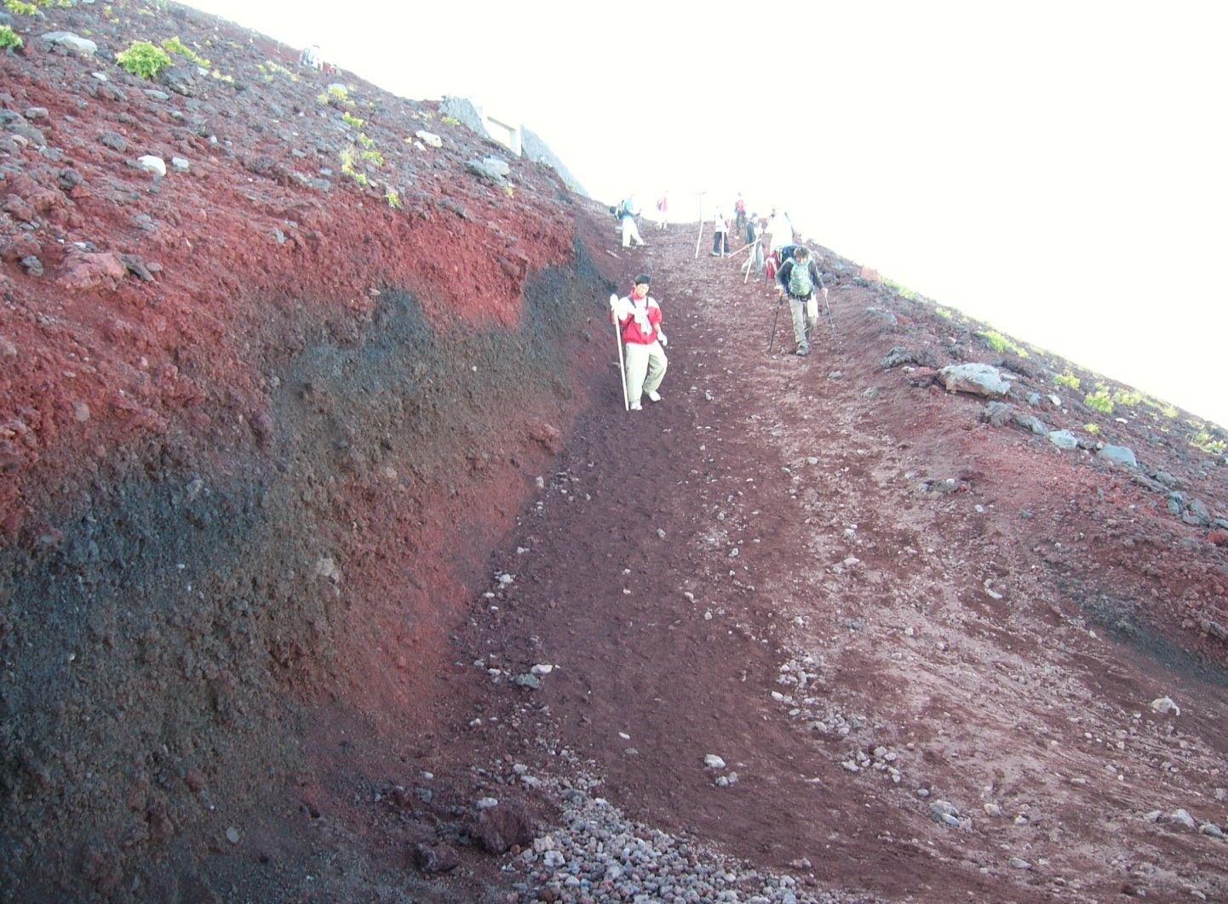
Heading down
It’s all loose gravel from here!

Slide 42
Warning ②
Injuries typically occur during the descent phase because you are worn out from climbing.

Slide 43
Before heading down
Make sure your shoelaces are tied good and tight. You need all the support of your boots at the ankles when descending.
If you have trekking poles, set the length longer than you had them on your ascent and brace yourself as you go down.
Keep in mind that there are only 3 restrooms until you make it back to the 5th station.
Pay attention for the main split at Edoya hut.

Slide 44
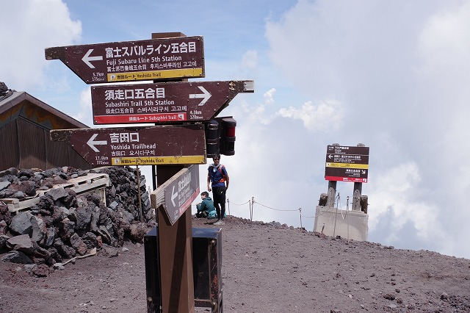
Sign at the main split. Go left!

Slide 45
Warning ③
Afternoon weather is frequently unstable, rain and thunderstorms are common.
If you hear thunder or sense any abrupt change in weather, promptly enter a shelter at any nearby mountain hut.

Slide 46
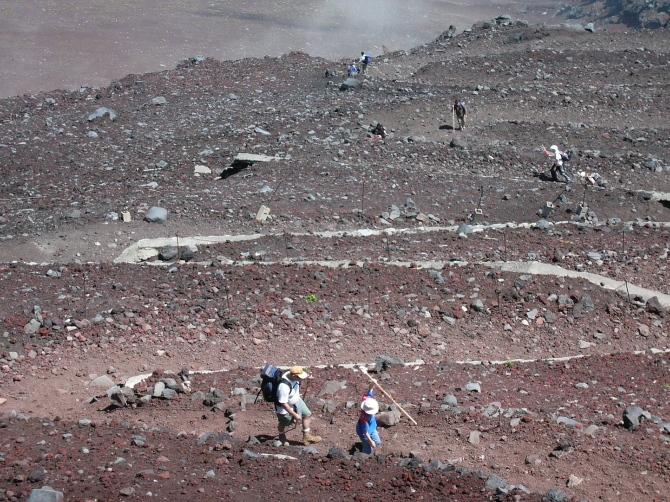
Long long walk and …

Slide 47
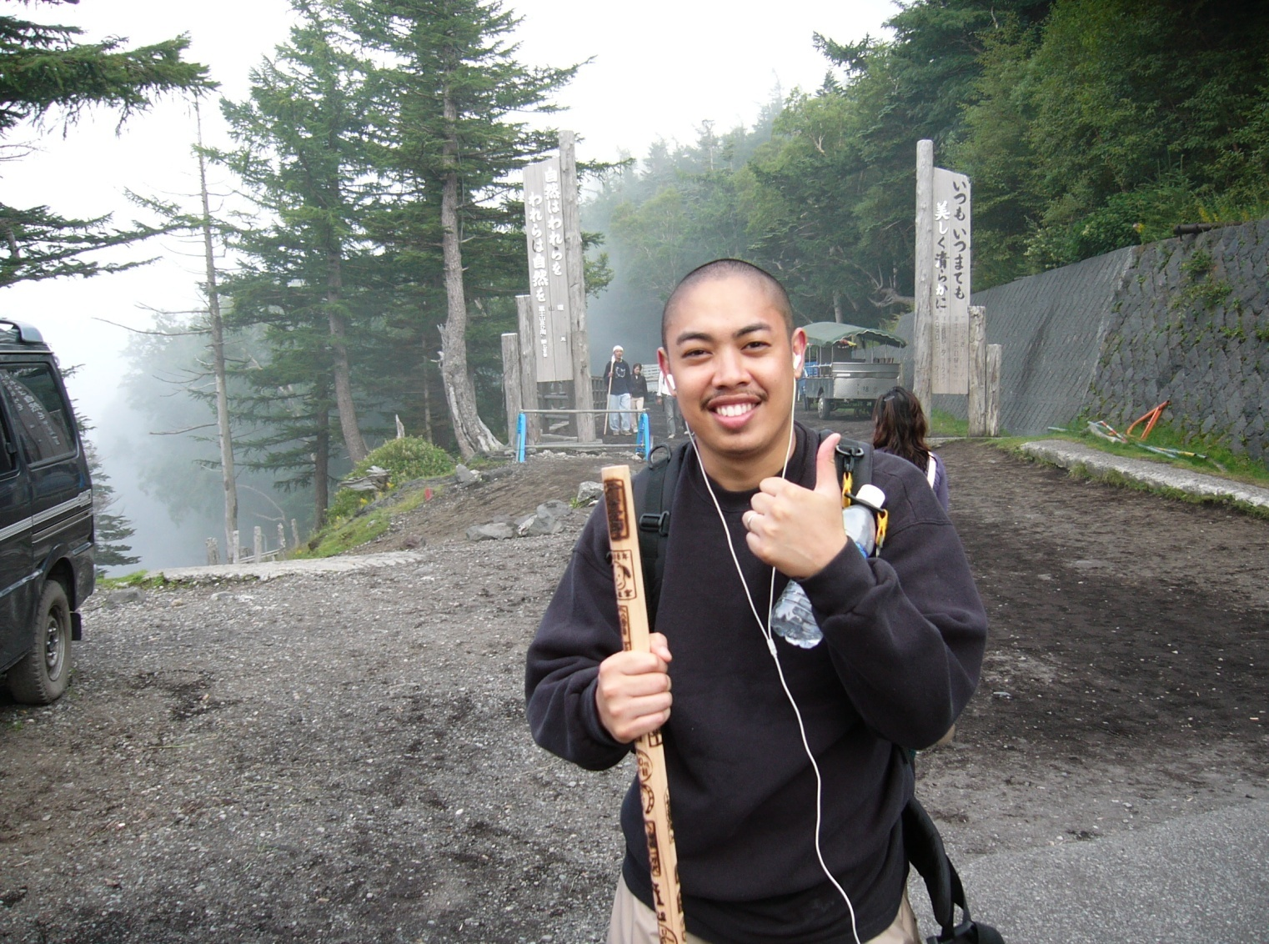
Finished! Back at the 5th station

Slide 48
Please Be Considerate
Trash on Mt. Fuji is a serious problem.
There are no trashcans on Mt. Fuji.
If you “Pack it in”, you must “Pack it out”.
Please do not litter on the mountain and be careful not to damage the trees.

Slide 49
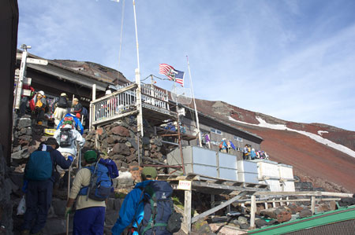
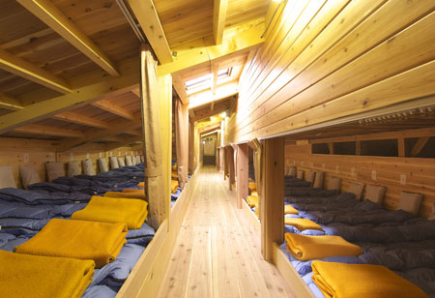
Overnight Trip Lodging Information
They are open only during the hiking season.
Toilets are outside the hut, but no shower facilities.
The hut on the mountain are rugged style huts.

Slide 50
Overnight Trip Lodging Information
All guests have to share one large room with the other hikers.
The hut provides a sleeping bag.
You will receive a simple dinner and breakfast at the hut on our Overnight Trip.

Slide 51
Warning ④
If you have a positive Sickle Trait or Sickle Cell Disease, even if you have never been ill from it, we advise you not to climb Mt. Fuji.

Slide 52
Warning ⑤
The warnings mentioned in this slideshow are not a joke, every year inadequately prepared people die on Fuji.

Slide 53
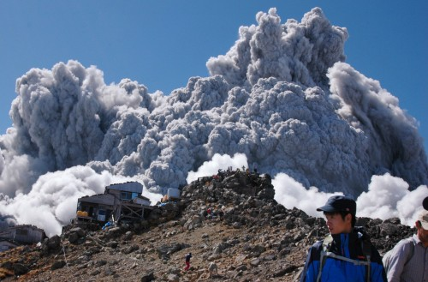
Warning ⑥
Mt. Fuji is an active volcano, standing at the junction between the Pacific, Eurasian and Philippine tectonic plates.

Slide 54
Japan earthquake has raised pressure below Mt. Fuji.
Mt. Fuji is now in a state of pressure, which means it displays a high potential for eruption. The risk is clearly higher.
On the list of the 47 peaks most at risk, according to the Japan Meteorological Agency, is Mount Fuji.
On 27 September 2014, Mt. Ontake, some 80 miles from Mt. Fuji, erupted without warning – killing 56 people and leaving at least 7 others missing in Japan's deadliest volcanic episode for almost 90 years.

Slide 55
Some advice
If your symptoms of altitude sickness is getting worse, it is wise to head down and return to the bus. If you force yourself and keep going it’s just going to get worse, plus you need energy to go back to the bus!
You don’t have to climb all the way to the top, you can return to the bus anytime you like.
If you are above the 8th station there are some paths to cut across to the descent trail, otherwise just go down the ascent trail.

Slide 56
Please bring your Mt. Fuji booklet
on the day of your trip,
you can download it from our Web.
https://yokotafss.com/odr/#fuji
The Mt. Fuji tour guide will answer any questions you have!
If you have any questions, please come to
Outdoor Recreation, Bldg. 564

Slide 57
GOOD LUCK!!

